Slide 1
Data Structure
Course code: cs-201
Topic: Trees in data structure
Instructor: habiba arshad

Slide 2
Binary Search Tree (BST)
Insertion
deletion

Slide 3
CLO Covered
CLO1: Explain the fundamentals of data structure as well as algorithms that operate on them GA2, BT C2
CLO2: Apply and design various data structures methods for specified applications. GA4, C3
CLO3: Analyze empirically the behavior of algorithms in terms of time and memory used. GA3, C4

Slide 4
Algorithm for Searching in BST
Search (root, item)
Step 1 - if (item = root → data) or (root = NULL)
return root
else if (item < root → data)
return Search(root → left, item)
else
return Search(root → right, item)
END if
Step 2 - END

Slide 5
Insertion in BST
A new key in BST is always inserted at the leaf.
To insert an element in BST, we have to start searching from the root node.
If the node to be inserted is less than the root node, then search for an empty location in the left subtree.
Else, search for the empty location in the right subtree and insert the data.
Insert in BST is similar to searching, as we always have to maintain the rule that the left subtree is smaller than the root, and right subtree is larger than the root.

Slide 6
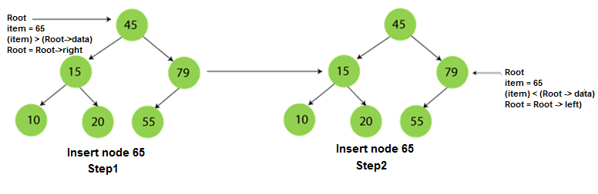
Insertion in BST
Insert 65:

Slide 7
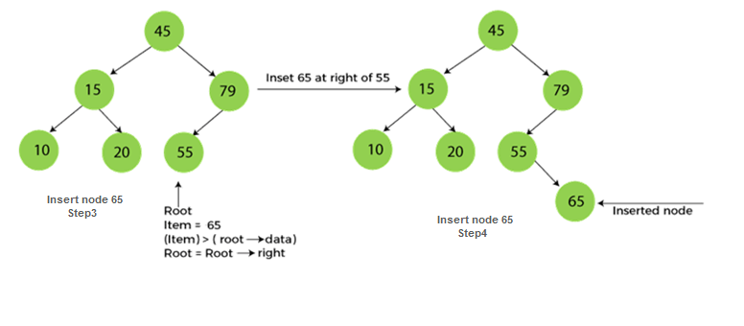
Insertion in BST

Slide 8
Insert 40, 60, 50, 33, 55, 11 into an empty BST
40
40
40
40
60
60
60
33
1. ITEM = 40
50
50
2. ITEM = 60
3. ITEM = 50
4. ITEM = 33

Slide 9
Insert 40, 60, 50, 33, 55, 11 into an empty BST
40
40
60
33
60
33
50
11
50
55
55
5. ITEM = 55
6. ITEM = 11

Slide 10
Deletion in BST
In a binary search tree, we must delete a node from the tree by keeping in mind that the property of BST is not violated.
To delete a node from BST, there are three possible situations occur -
The node to be deleted is the leaf node, or, 0 child
The node to be deleted has only one child, and,
The node to be deleted has two children

Slide 11
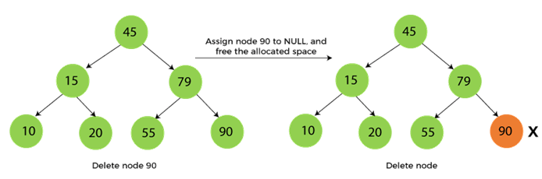
Deletion in BST
When the node to be deleted is the leaf node
Replace the leaf node with NULL and simply free the allocated space.
For Example, suppose we have to delete node 90, as the node to be deleted is a leaf node, so it will be replaced with NULL, and the allocated space will free.

Slide 12
Deletion in BST
When the node to be deleted has only one child
In this case, we have to replace the target node with its child, and then delete the child node.
It means that after replacing the target node with its child node, the child node will now contain the value to be deleted.
So, we simply have to replace the child node with NULL and free up the allocated space.

Slide 13
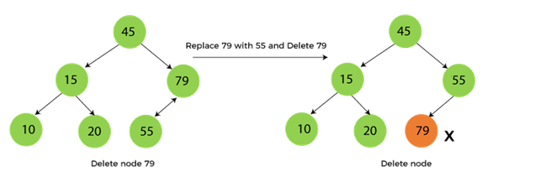
Deletion in BST
When the node to be deleted has only one child
For example, suppose we have to delete the node 79, as the node to be deleted has only one child, so it will be replaced with its child 55.
So, the replaced node 79 will now be a leaf node that can be easily deleted.

Slide 14
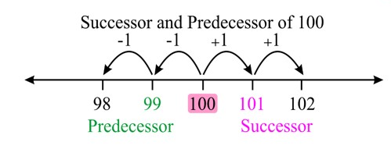
Deletion in BST
When the node to be deleted has two children
This case of deleting a node in BST is a bit complex among other two cases. As, we have to decide what value will be on root node.
To replace the root node two situations would be followed
Replace the deleted node with;
Inorder predecessor
Inorder successor
This would result in two BST’s

Slide 15
Deletion in BST
Inorder Successor: In such a case, the steps to be followed are as follows -
First, find the inorder successor of the node to be deleted from the right subtree.
After that, replace that node with the inorder successor until the target node is placed at the leaf of tree.
And at last, replace the node with NULL and free up the allocated space.
The inorder successor is required when the right child of the node is not empty.

Slide 16
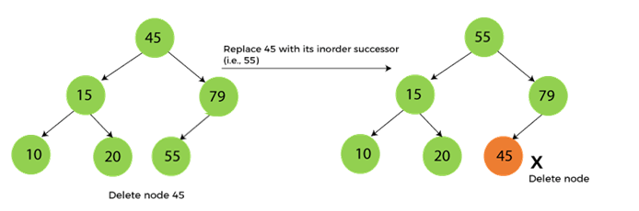
Deletion in BST
When the node to be deleted has two children
For example, suppose we want to delete node 45 that is the root node, as the node to be deleted has two children, so it will be replaced with its inorder successor. Now, node 45 will be at the leaf of the tree so that it can be deleted easily.

Slide 17
Deletion in BST
Inorder Predecessor: In such a case, the steps to be followed are as follows:
First, find the inorder predecessor of the node to be deleted from the left sub tree.
After that, replace that node with the inorder predecessor until the target node is placed at the leaf of tree.
And at last, replace the node with NULL and free up the allocated space.
The inorder predecessor is required when the left child of the node is not empty.

Slide 18
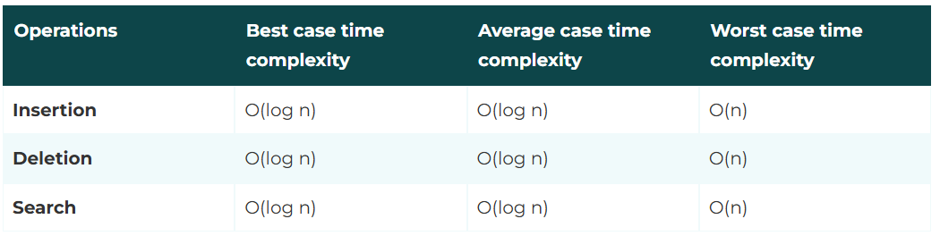
Time Complexity of various operations of BST

Slide 19
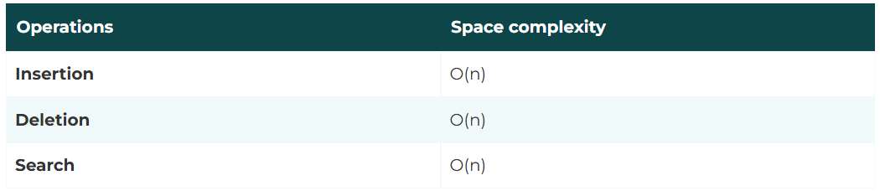
Space Complexity of various operations of BST

Slide 20
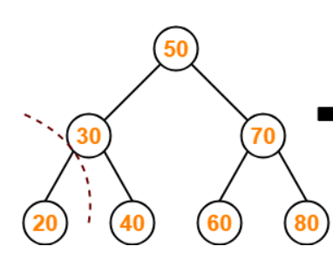
Task (Deletion)
Perform deletion in the following tree:
Delete 30
Delete 50
Delete 60

Slide 21
Reference links
Insertion
https://youtu.be/sXABdGalFNg
Deletion
https://youtu.be/hL9RUD33nYs

